Slide 1
ANT COLONY OPTIMIZATION
By:
P Geetha Sri
(188T1A0544)

Slide 2
abstract
Swarm intelligence is a relatively new approach to problem solving that takes
inspiration from the social behaviors of insects and of other animals. In particular,
ants have inspired a number of methods and techniques among which the most
studied and the most successful is the general purpose optimization technique
known as ant colony optimization. Ant colony optimization (ACO) takes inspiration
from the foraging behavior of some ant species. These ants deposit pheromone on
the ground in order to mark some favorable path that should be followed by other
members of the colony. Ant colony optimization exploits a similar mechanism for
solving optimization problems. From the early nineties, when the first ant colony
optimization algorithm was proposed, ACO attracted the attention of increasing
numbers of researchers and many successful applications are now available.
Moreover, a substantial corpus of theoretical results is becoming available that
provides useful guidelines to researchers and practitioners in further applications of
ACO. The goal of ant colony optimization and to survey its most notable
applications.

Slide 3
contents
Introduction
Swarm Intelligence
Examples
ACO Concept
Ant Communication

Slide 4
HUMAN NATURE RELATIONSHIP
We humans think we are the ultimate in all aspects but we too learn a lot from other living beings.
We depend for our food on plants and animals.
In terms of technology, we still perform some experiments on animals and obtain results.
In our topic we see what we have learnt from ants.

Slide 5
Swarm intelligence (SI):-
Describes the collective behavior of decentralized,
self-organized systems, natural or artificial. The concept is employed in work on artificial intelligence
Swarming theory
Related to bird flocking, fish schooling
- steer toward the center
- match neighbors’ velocity
- avoid collisions

Slide 6
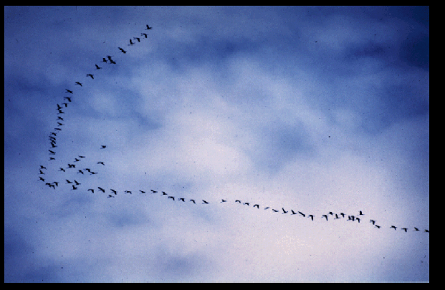
BIRD FLOCKING

Slide 7
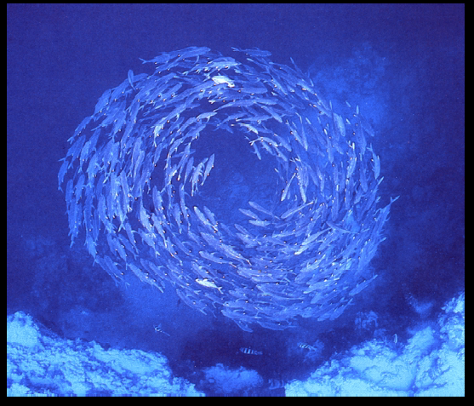
FISH SCHOOLING

Slide 8
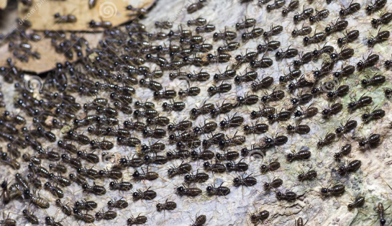
ANT COLONY

Slide 9
ACO CONCEPT
THE WHOLE CONCEPT OF ANT COLONY OPTIMIZATION IS TO MINIMIZE THE PATH AND POWER CONSUMPTION
“Ant Colony Optimization (ACO) studies artificial
systems that take inspiration from the behavior of
real ant colonies and which are used to solve
discrete optimization problems.”

Slide 10
PRACTICALLY
Ants (blind) navigate from nest to food source
Shortest path is discovered via pheromone trails
each ant moves at random
pheromone is deposited on path
ants detect lead ant’s path, inclined to follow
more pheromone on path increases probability of path being followed

Slide 11
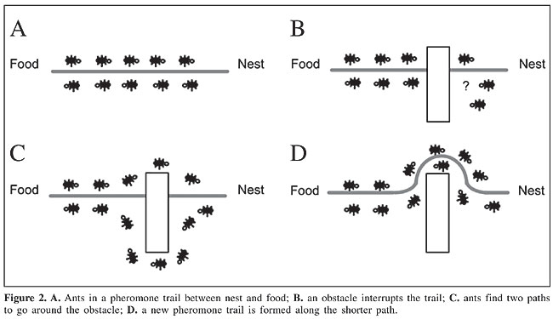
ANT COMMUNICATION

Slide 12


